Slide 1
Solutions for Liquor Recommendation System based on Images
Asian Frontier ft Sun Asterisk

Slide 2
Presentation Content
Recommendation-based Images System Introduction
Possible solution for liquor recommendation-based images
OCR (Optical Character Recognition) Algorithm
Images-based images search Algorithm
Conclusion

Slide 3

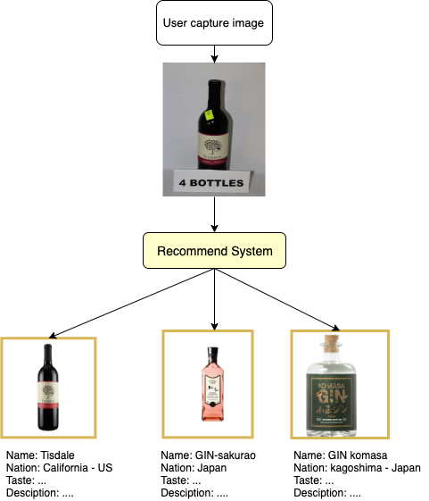
I. Recommendation-based Images System Introduction
- Operating system:

Slide 4
II. Solutions
There are two possible ways to build liquor recommendation-based images system
OCR (Optical Character Recognition) algorithm
Image-based images search algorithm

Slide 5
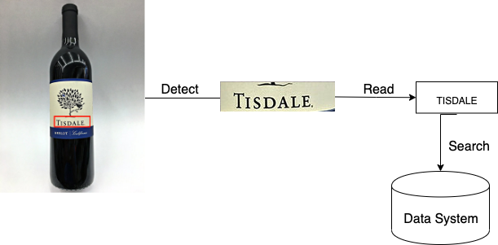
III. OCR (Optical Character Recognition)
Common pipeline:
Detect area that contain label such as product name, year of manufacture, etc…
Using a machine model to recognize text from the area
After retrieving text, we can find similar products that has similar text label from database.
Return results

Slide 6
III. OCR (Optical Character Recognition)
Advantages
Having ability in taking advantage of text label in each product
Disadvantages
Depending too much on languages, being unable to scale the whole system
Due to the diversity of color, font of text; therefore, it’s more hard to recognize text accurately from the liquor label
Requiring many phases to get results -> time response is large -> bad performance
Depending too much on the sence of image captured by users
Most Application fields
Text retriever from documents
Analyzing text from documents to find hidden pattern.

Slide 7
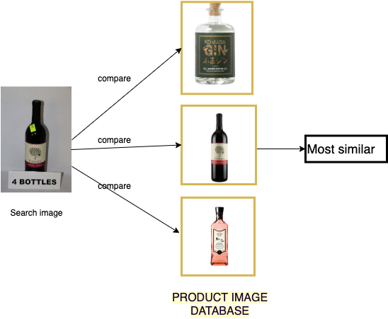
IV. Images-based images search Algorithm
Common pipeline:
Detect area that mostly contain liquor bottle
Using the bottle image detected as an input of recommendation system
The system will find similar products from database based on color, shape of the bottle, shape of the product label
Return results

Slide 8
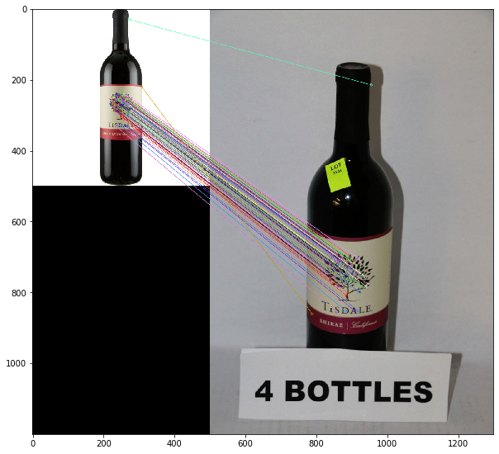
IV. Images-based images search Algorithm
Advantages
Having ability in utilizing many features from images such as shape of bottle, color, shape of product label
Only one phase required that detect the area of liquor bottle -> search -> better performance than OCR
Suitable with the view of end user
More intuitive, etc…
Disadvantages
Being unable in taking advantage of text label of each product.
Application fields
Face Recognition
Fashion Look Up
Car recommendation, etc…

Slide 9
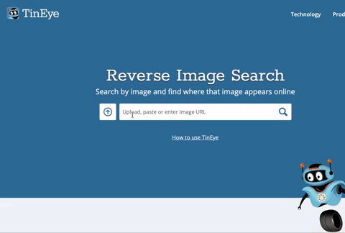
V. Conclusion
An example:

Slide 10
V. Conclusion
For commercial purpose, images-based images algorithm has been recommened more than OCR algorithm
With images-based images algorithm, products recommended are more diverse, more approachable to end users
Scores:
Images-based images: 4/5
OCR: 2/5

Slide 11
Thank you for listening!

